Slide 1

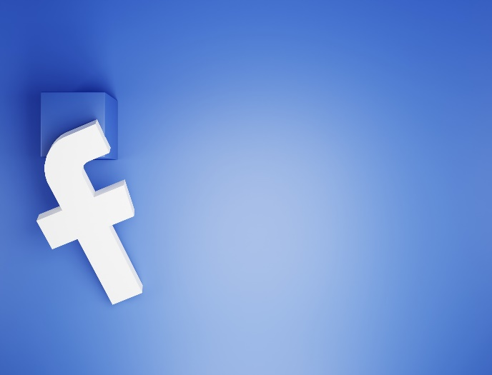
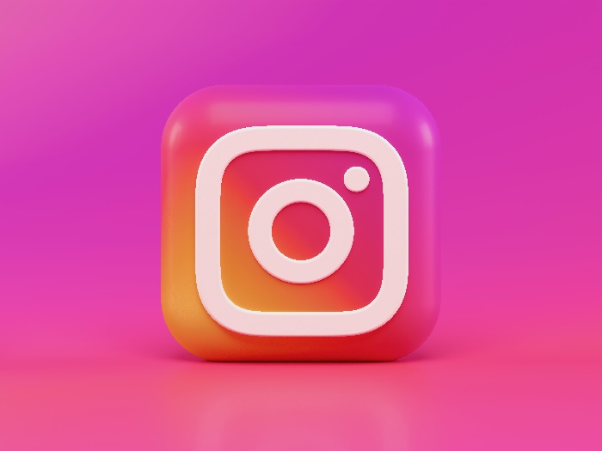
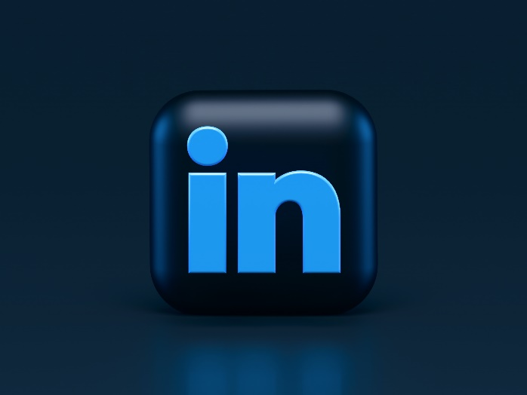
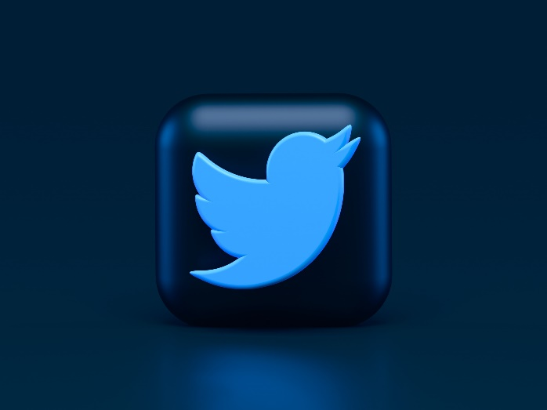

SOCIAL MEDIA ANALYSIS
PRESENTED BY :
NAOMI MUTHEU RICHARD

Slide 2
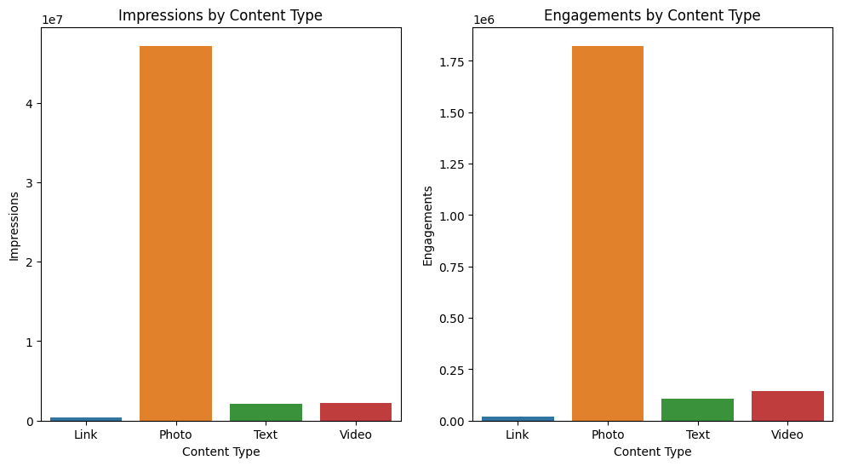
FACEBOOK ANALYSIS
Photo is the leading content type in all engagement metrics, including impressions, engagements, reactions, likes, shares, and negative comments.
This suggests that photo posts are the most effective way to reach and engage your audience.

Slide 3
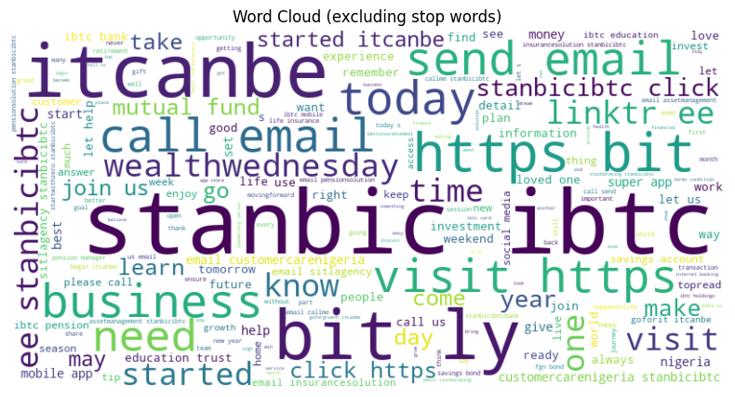
FACEBOOK WORD CLOUD

Slide 4
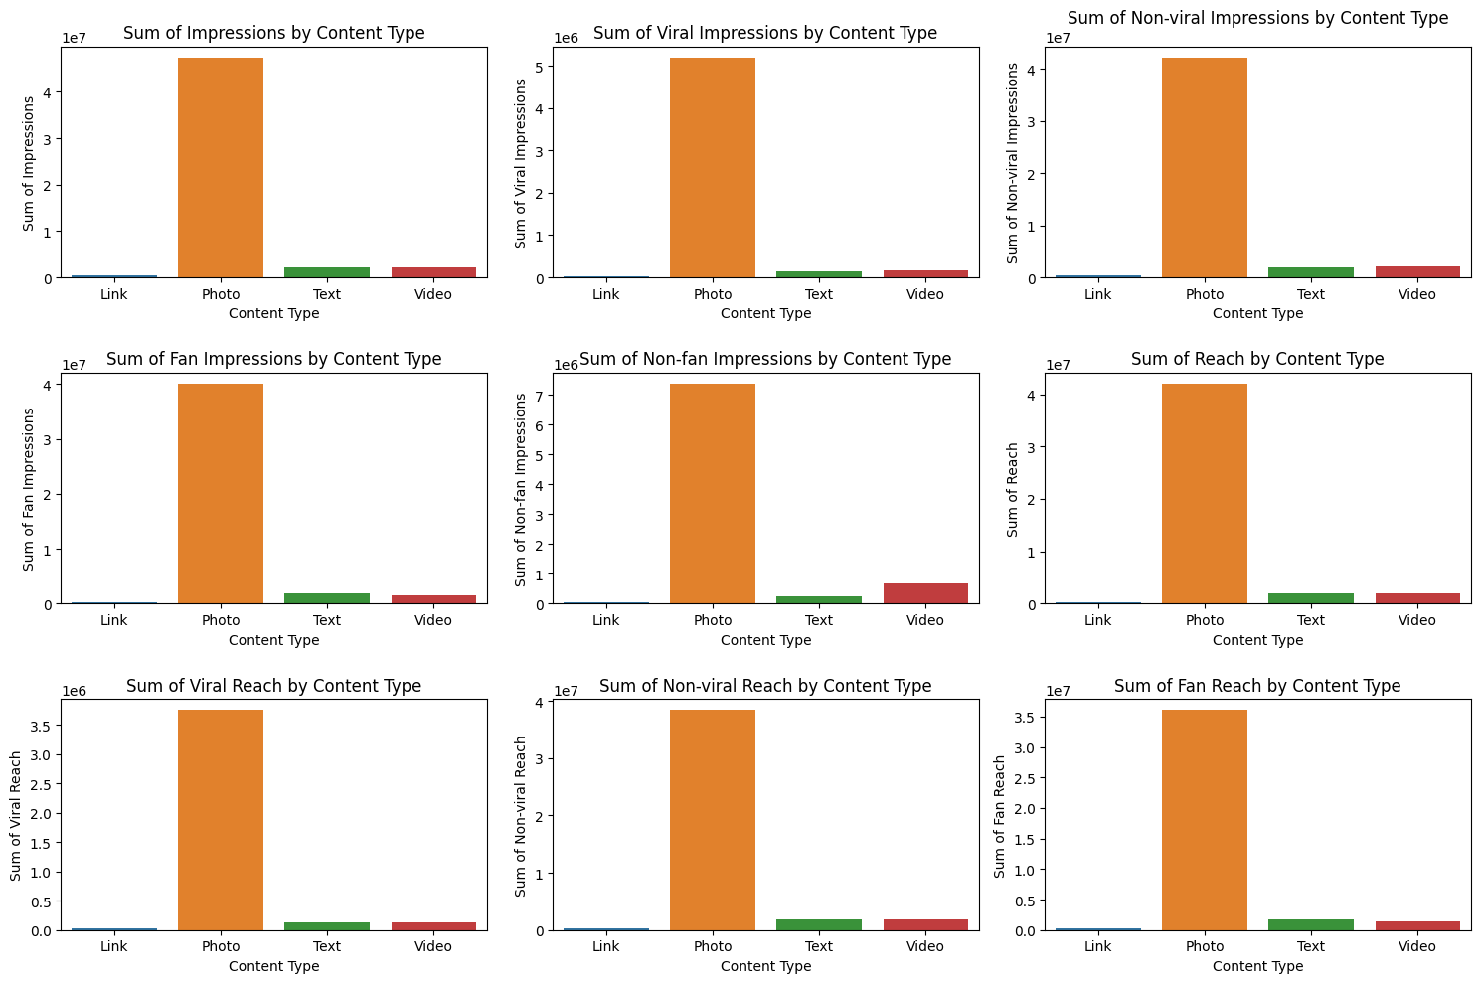
Impression Analysis
Photos outperform other content types, achieving the highest impressions, including Impressions, Viral Impressions, Non-viral Impressions, Fan Impressions, Non-fan Impressions, Reach, Viral Reach, Non-viral Reach, and Fan Reach, while links receive the lowest number of impressions.

Slide 5
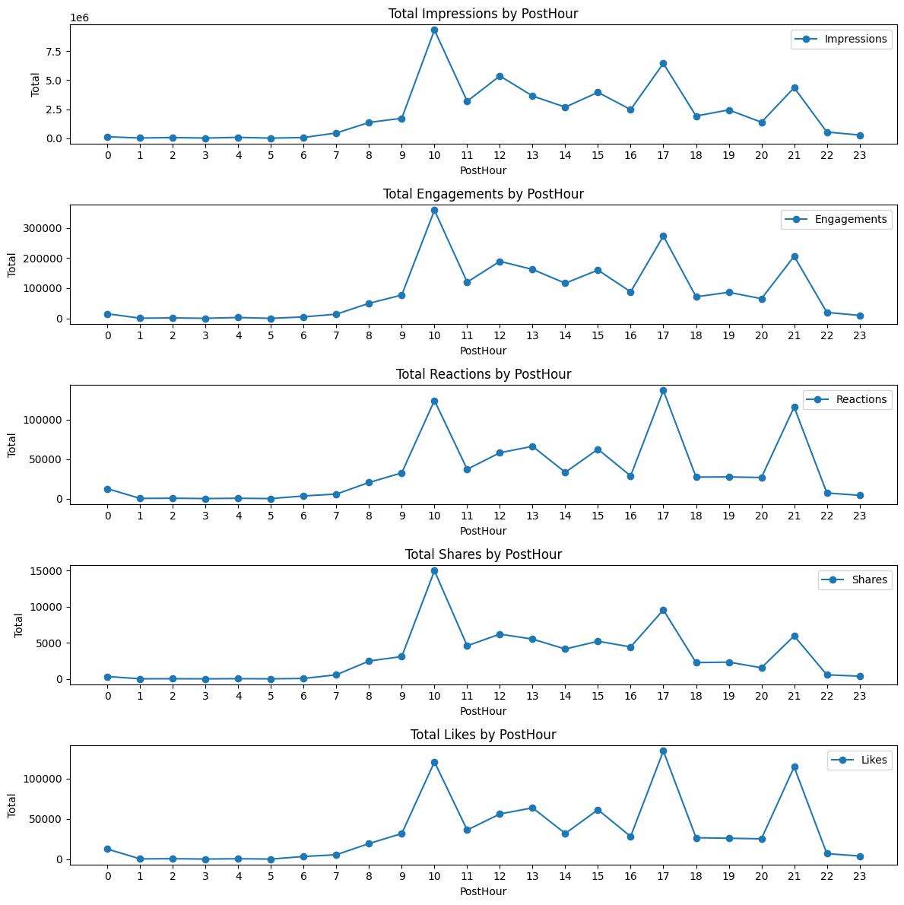
Time Analysis(Facebook)
Most of the posts appear in people’s feeds at 10 am and 5 pm.
People are most likely to engage, react, and share with posts at 10 am, 5 pm, and 9 pm.
Similar to the time people engage with the posts most likes occur at the same time 10 am, 5 pm, and 9 pm.

Slide 6
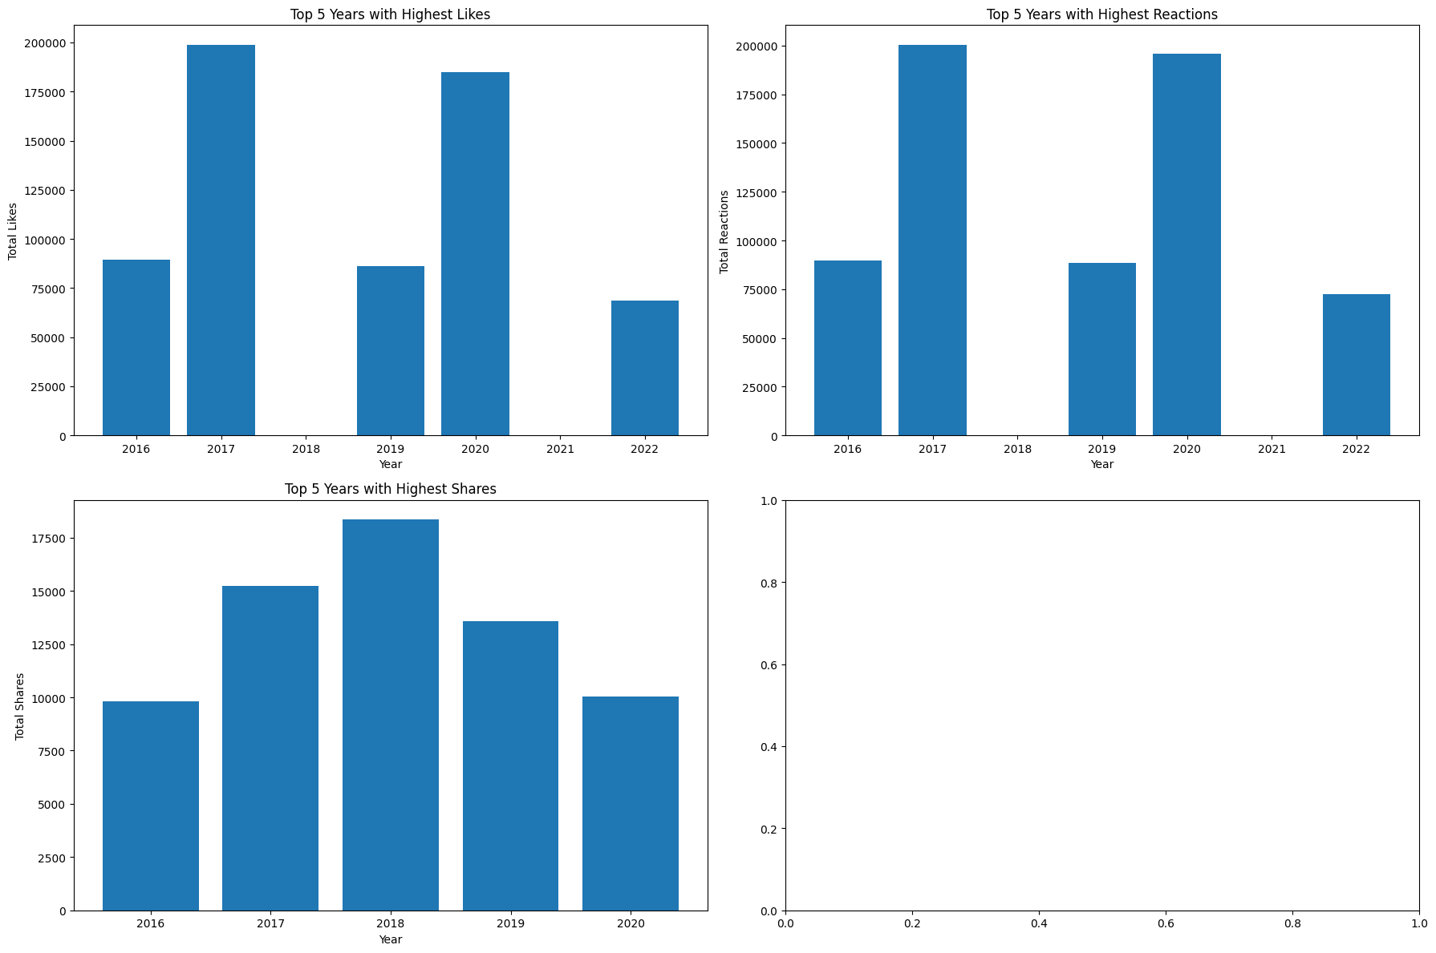
Yearly Analysis
2016, 2017, 2019, 2020, and 2022 were the top 5 years with the most likes and 2017 led with over 180,000 likes.
2016,2017,2019,2020, and 2022 were the top 5 years with the most reactions and 2017 led with over 180,000 reactions.
2016,2017,2018,2019, and 2020 were the top 5 years with the most shares, and 2018 led with over 16000 shares.

Slide 7
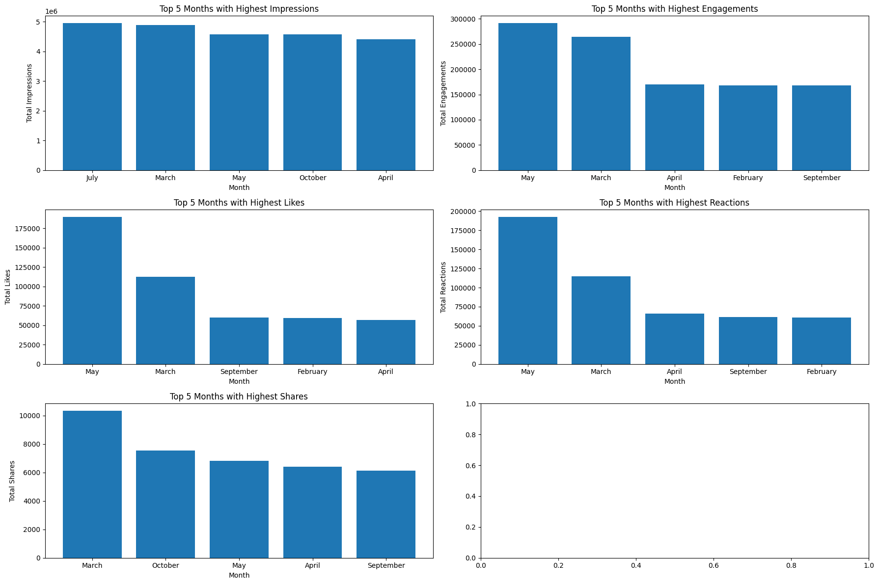
Monthly analysis
Most of the months that led in engagements, impressions, likes, reactions, and shares were March, April, May, and September.
Leading with the highest impressions was July.
Leading with the highest engagements, likes and reactions was May.
Leading with the highest shares was March.

Slide 8
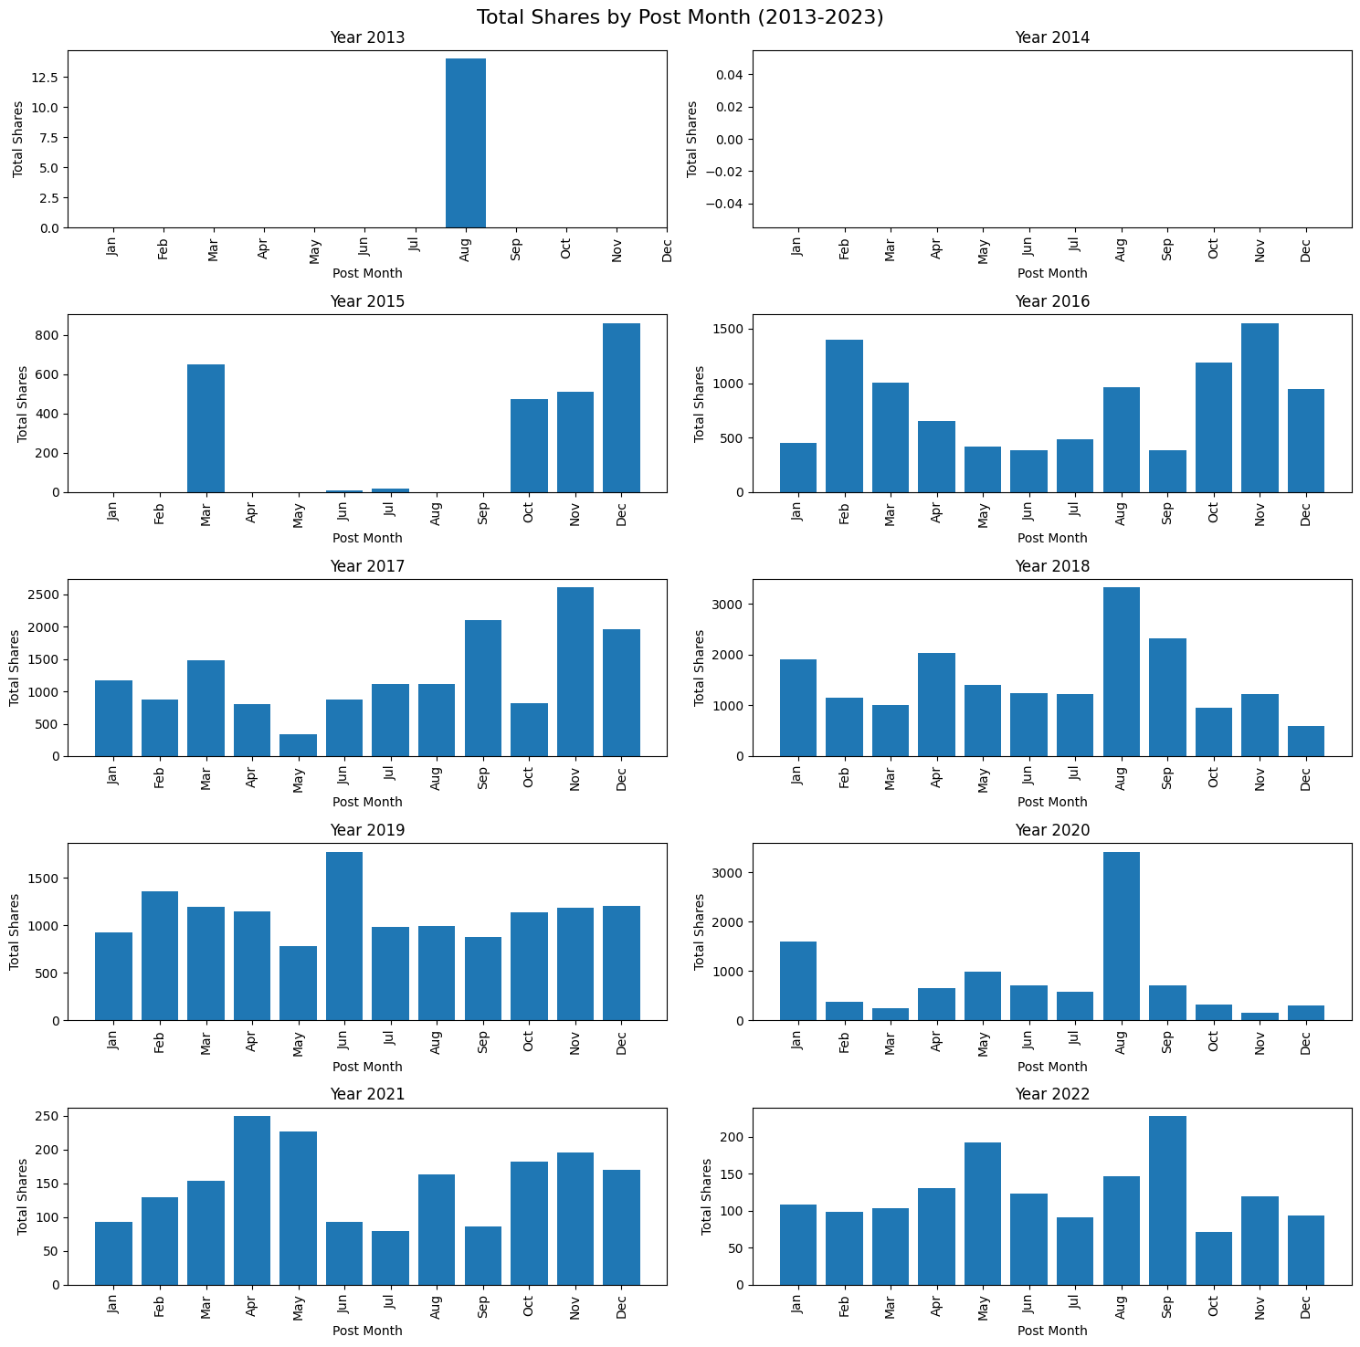
Total Shares by Post Month in last 10 years(2013 – 2023)

Slide 9
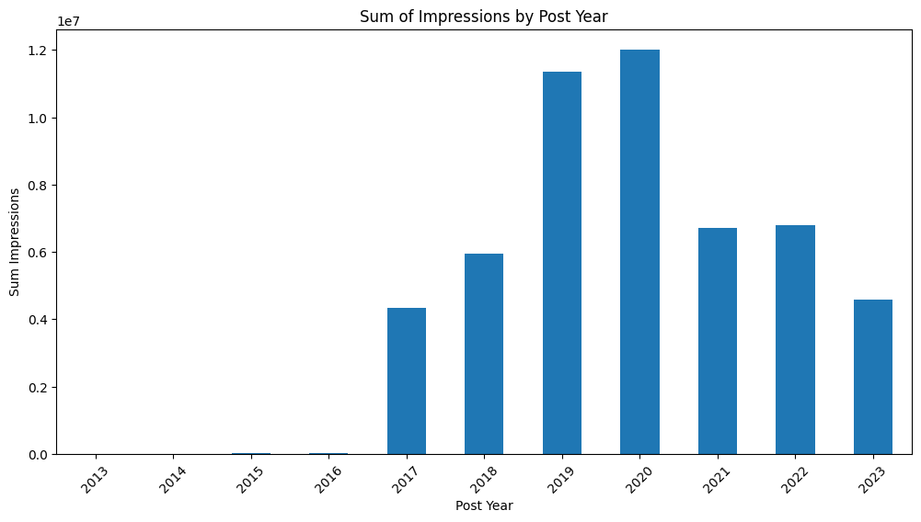
Sum of Impressions by Post Year

Slide 10
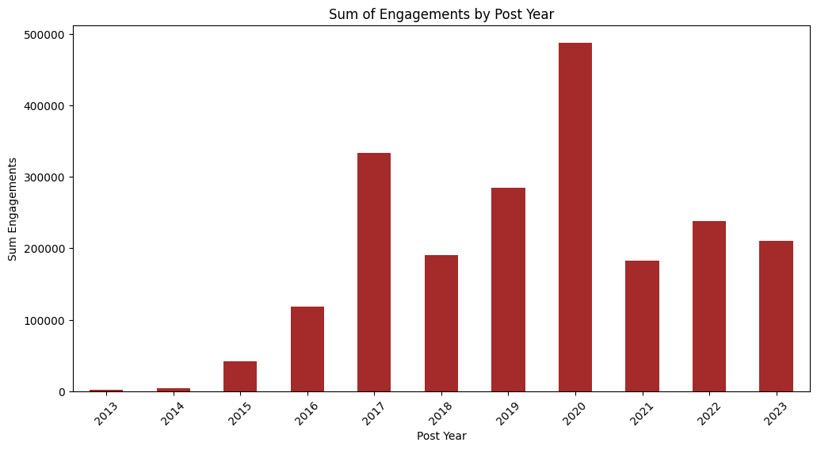
Sum of Engagements by Post Year

Slide 11
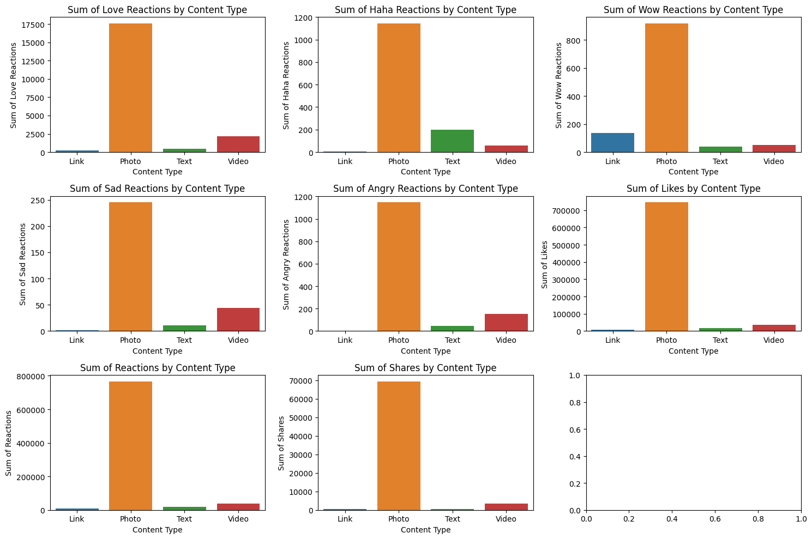
Sum of reactions, likes, and shares by content type

Slide 12
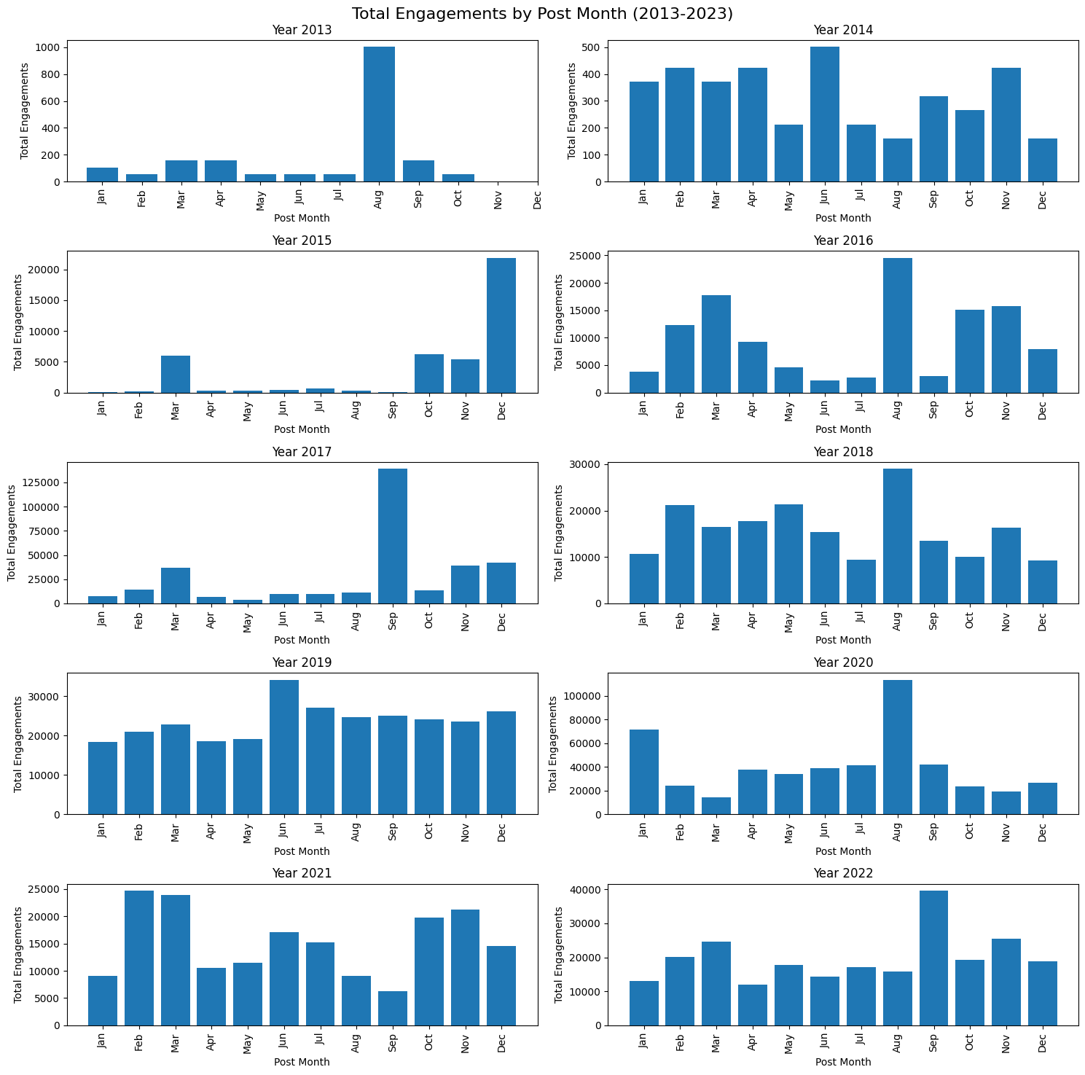
Total Engagements by Post Month in last 10 years(2013 – 2023)

Slide 13
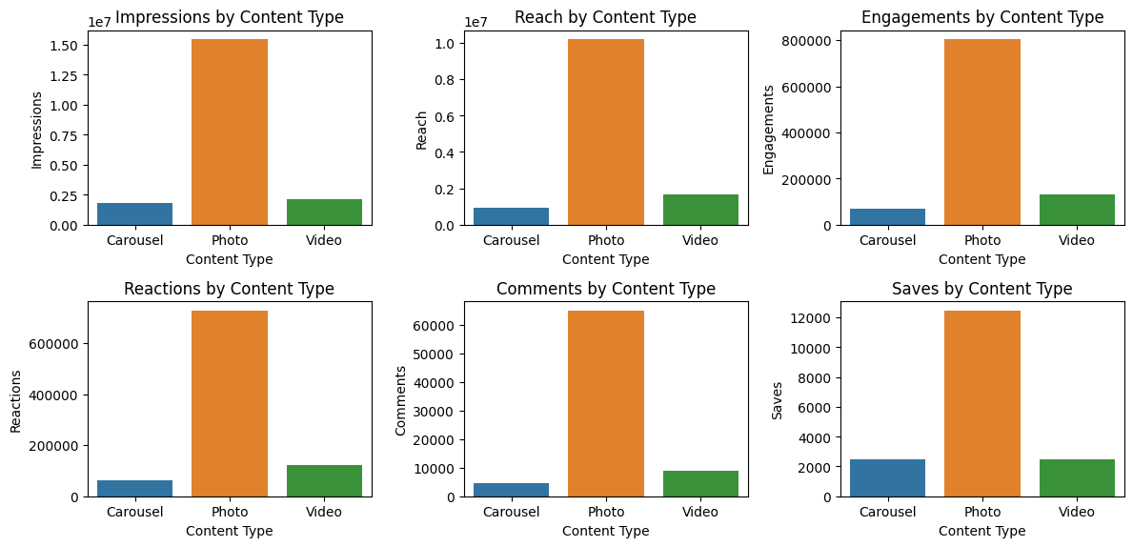
INSTAGRAM ANALYSIS
Photo is the leading content type on Instagram in all engagement metrics, including impressions, engagements, reach, reactions, comments, and saves.

Slide 14
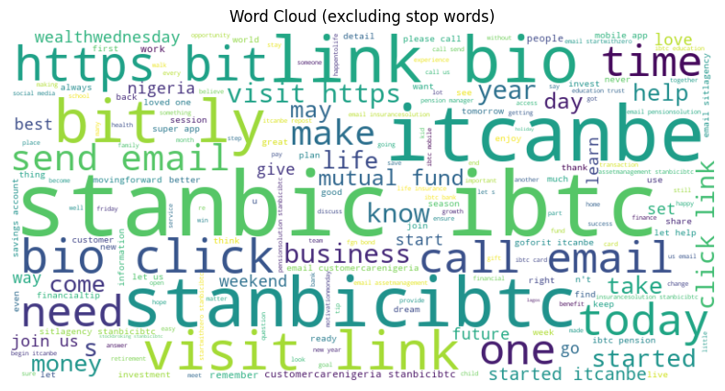
INSTAGRAM WORD CLOUD

Slide 15
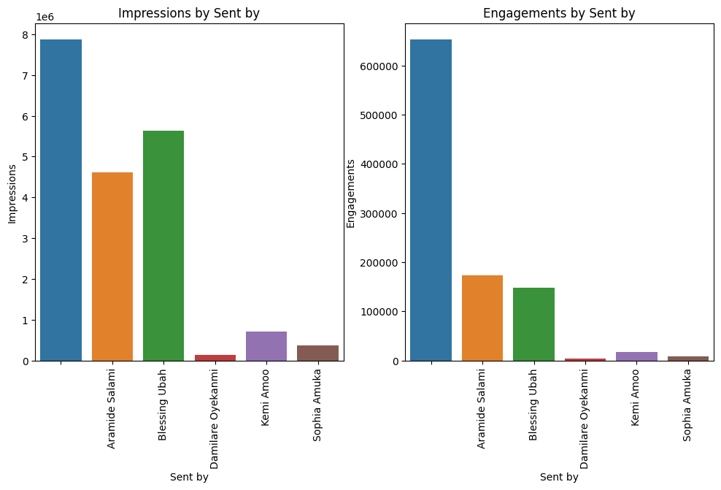
Sent By Highest Impressions and Engagements
Most people engage with posts sent by Unknown, Araminde, and Blessings Ubah, and the least sent by Damilare Oyekanmi and Sophia Amuka.

Slide 16
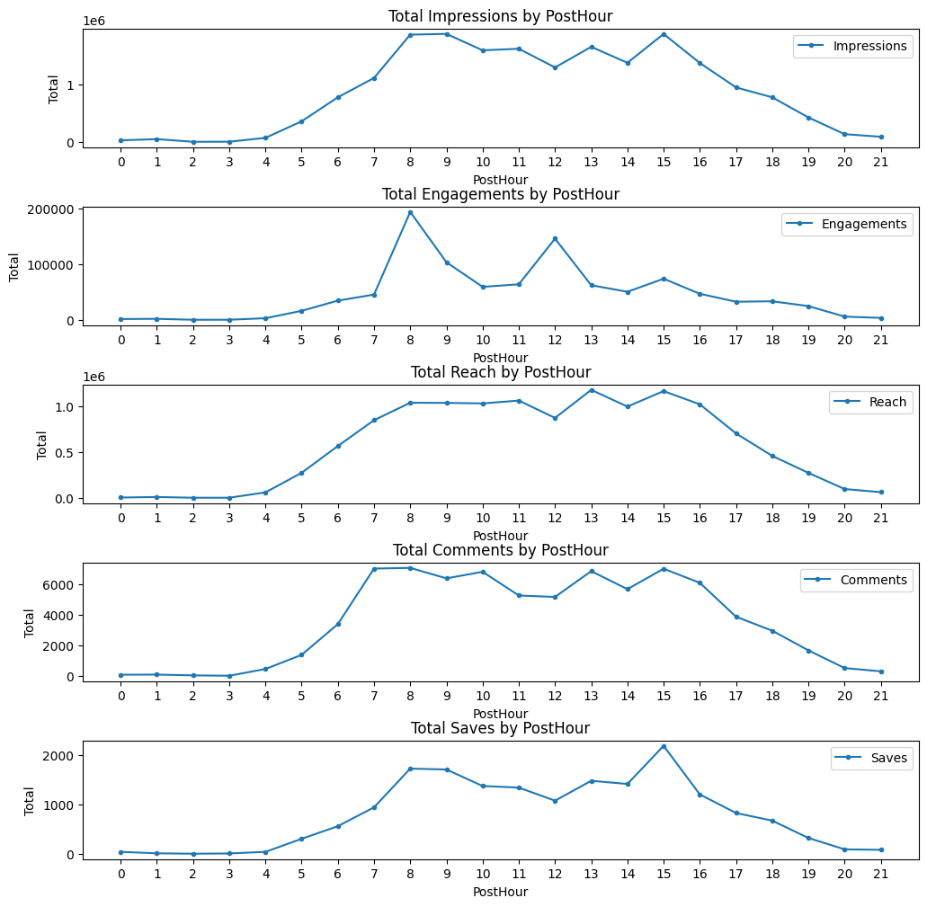
Time series Analysis (Instagram)
Most people engage with Instagram posts at 8 am and 12 noon, and impressions from 6 am to 4 pm.
Comments are made from 6 am to 4 pm, reach lies between 7 am to 4 pm.
Saves are made at 8 am and 3 pm.

Slide 17
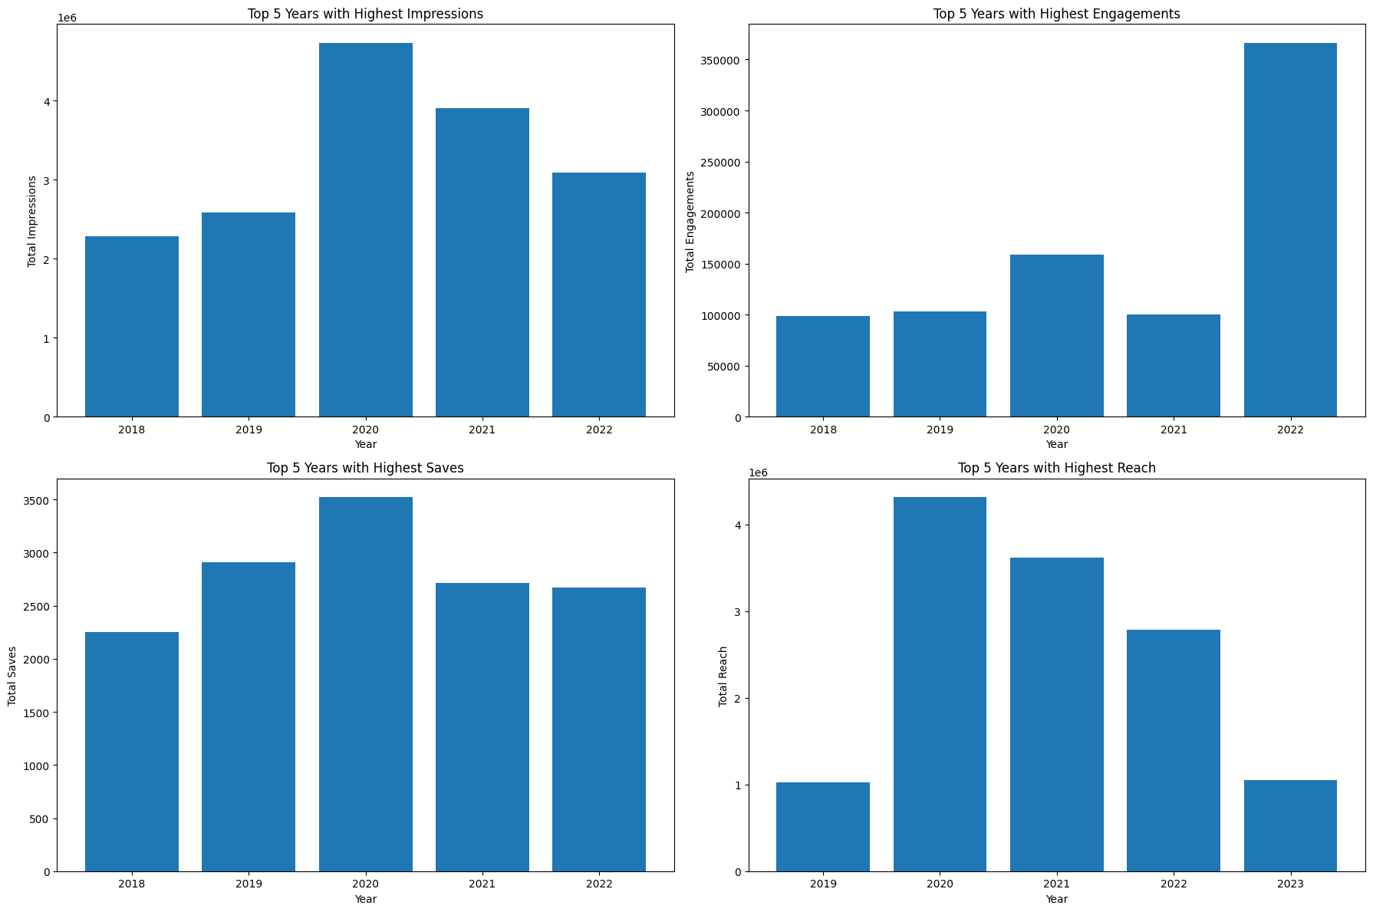
Yearly Analysis
2020 led with the highest impression rate, highest reach rate, and highest number of saves
2022 led with the highest engagement rate.

Slide 18
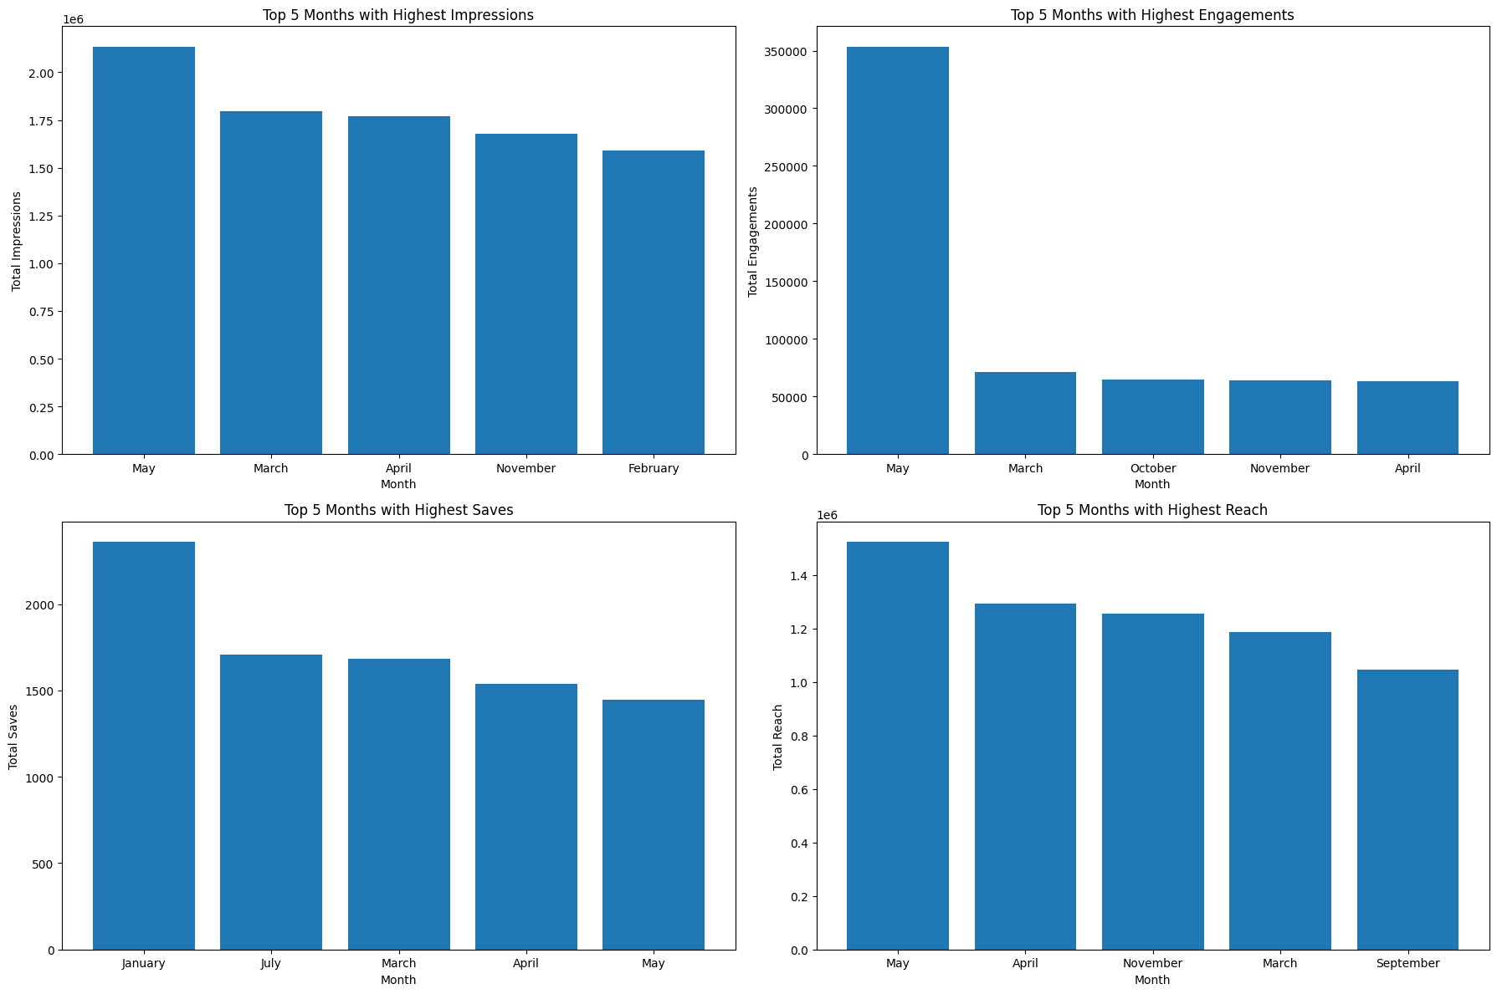
Monthly Analysis
Most of the months that led in engagements, impressions, reach and saves were March, April, and May.
May led with the highest rate in Impressions, Engagements, and reach.
January led with the highest number of saves.

Slide 19
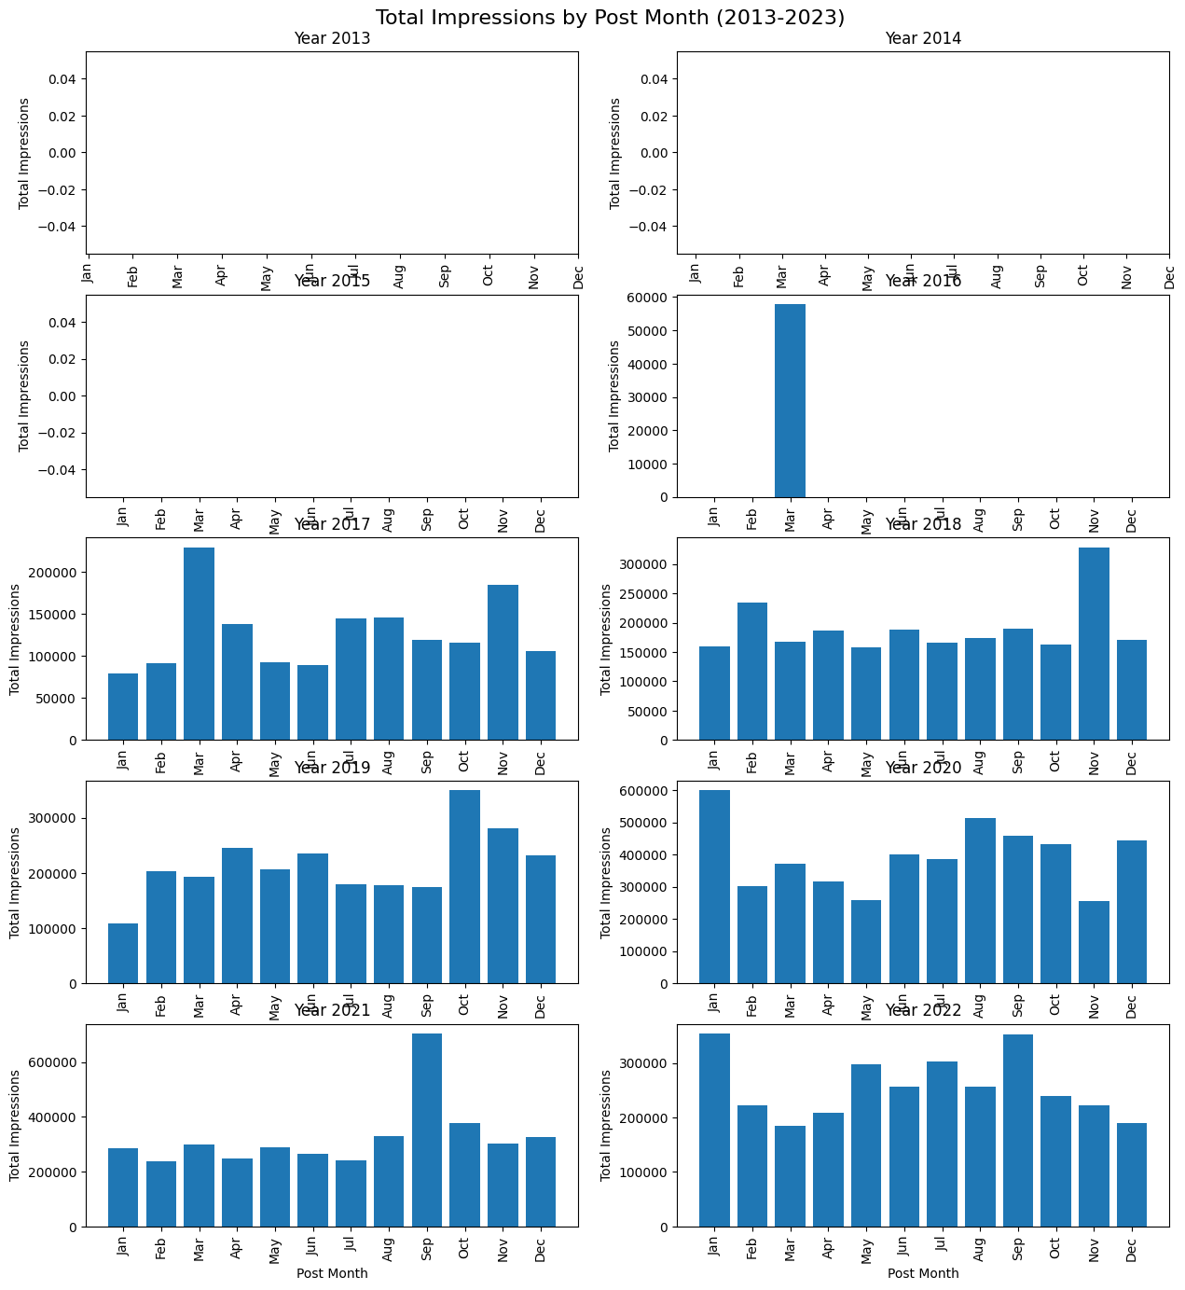
Total Impressions in the last 10 years

Slide 20
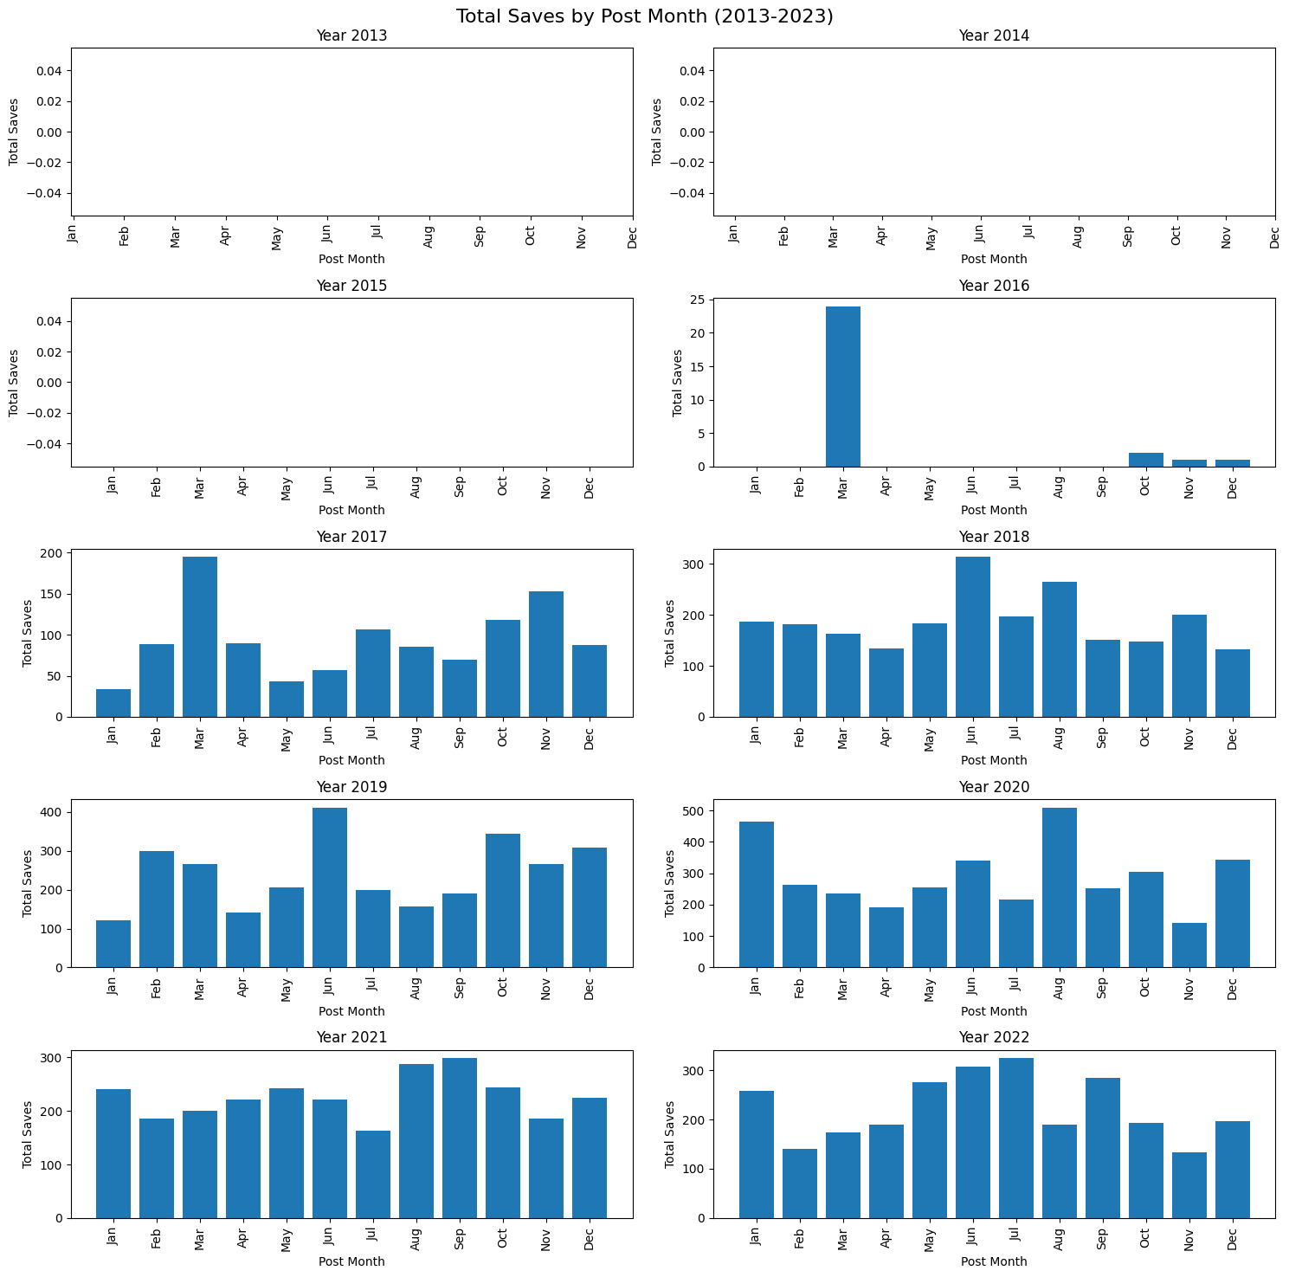
Total Saves In the last 10 years

Slide 21
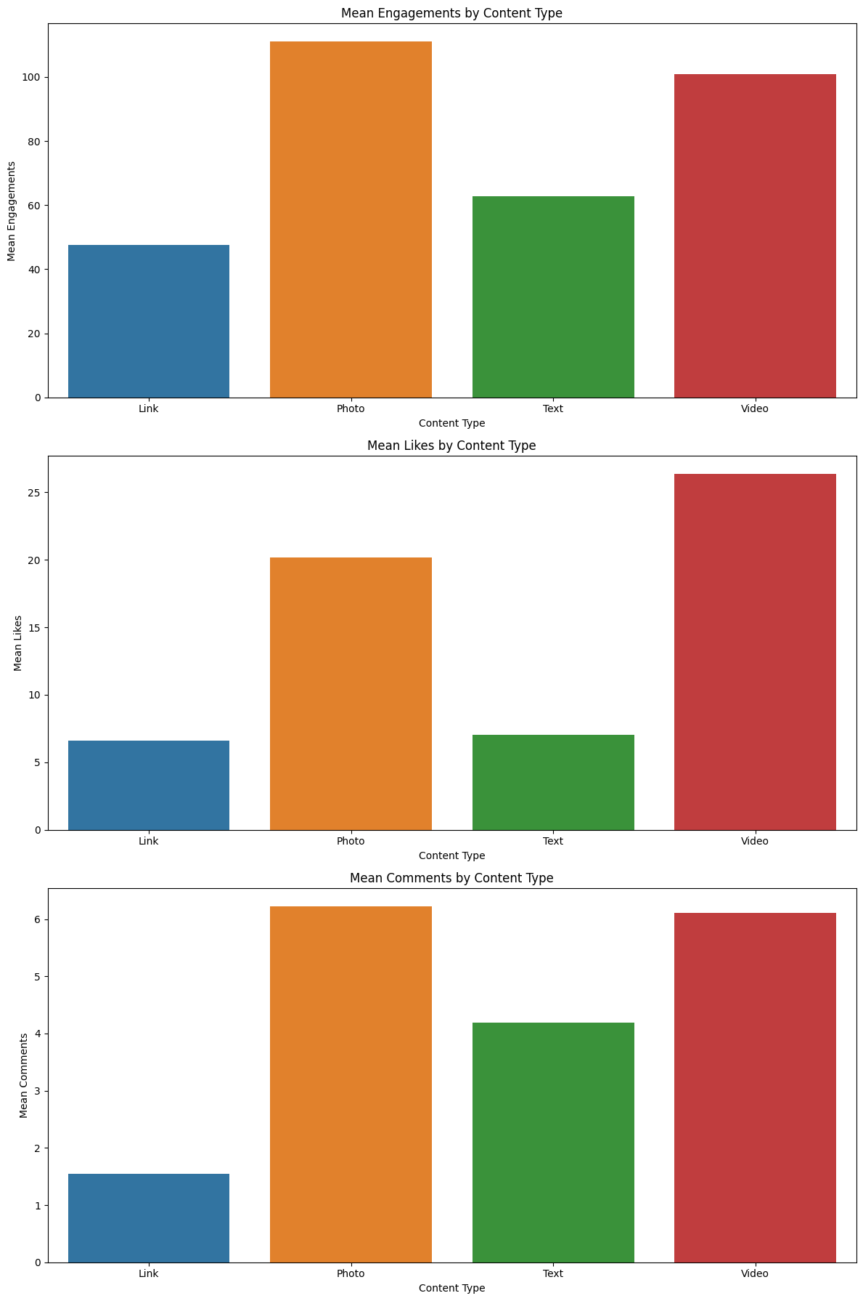
TWITTER ANALYSIS
Photo content ranks highest in terms of engagement, closely followed by video content.
A significant majority of our audience shows a strong preference for video content.
Photos tend to receive the most comments compared to other content types.

Slide 22
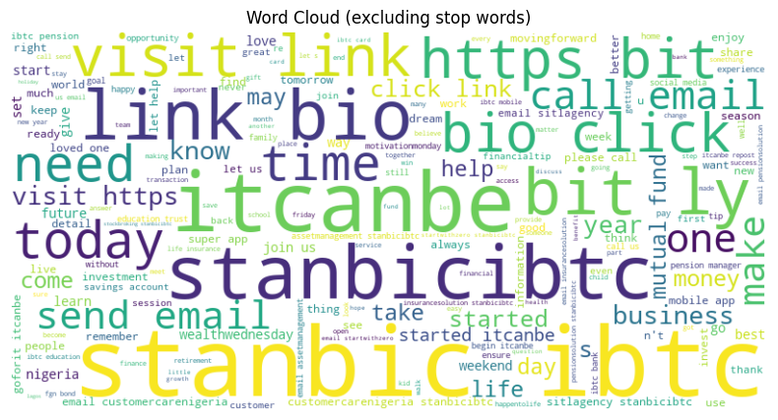
TWITTER WORD CLOUD

Slide 23
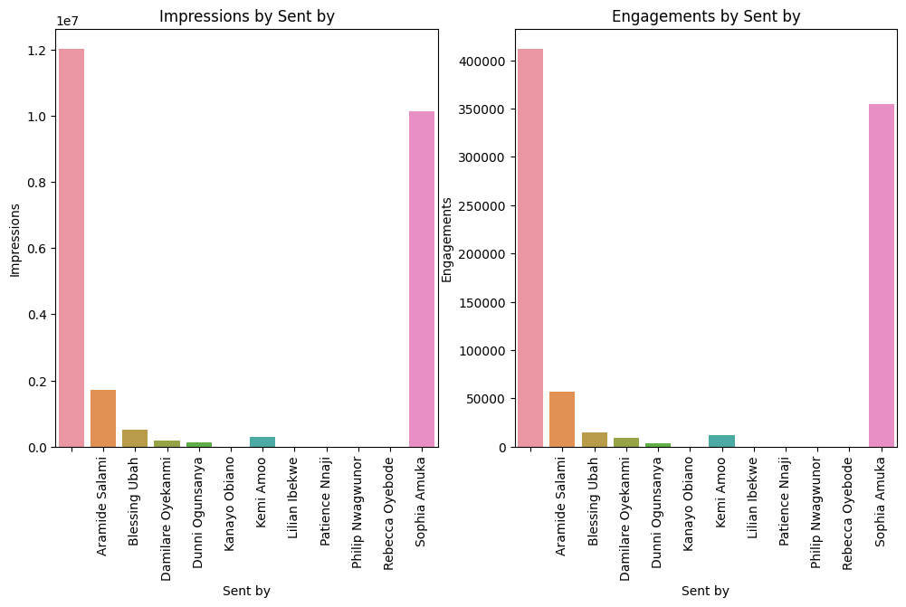
Sent By Analysis
Within the Twitter(X) platform, 'Others' and Sophia Amuka have consistently generated the highest number of impressions and engagements.

Slide 24
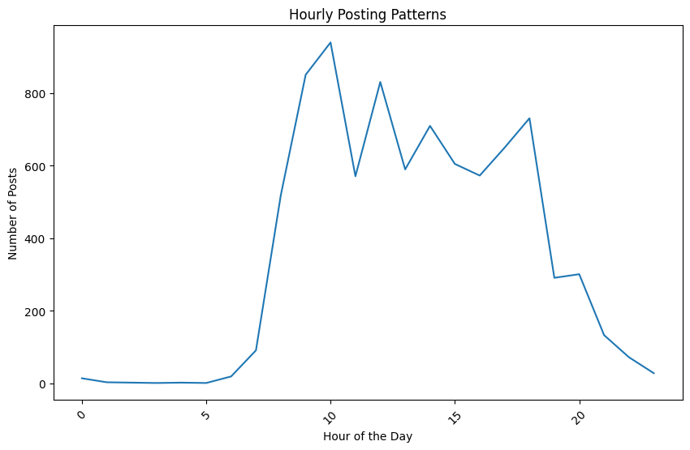
Time series analysis
The majority of audience engagement on Twitter is concentrated during the peak hours of 10 a.m. and 5 p.m., with the least engagement observed during the early morning and late evening hours.

Slide 25
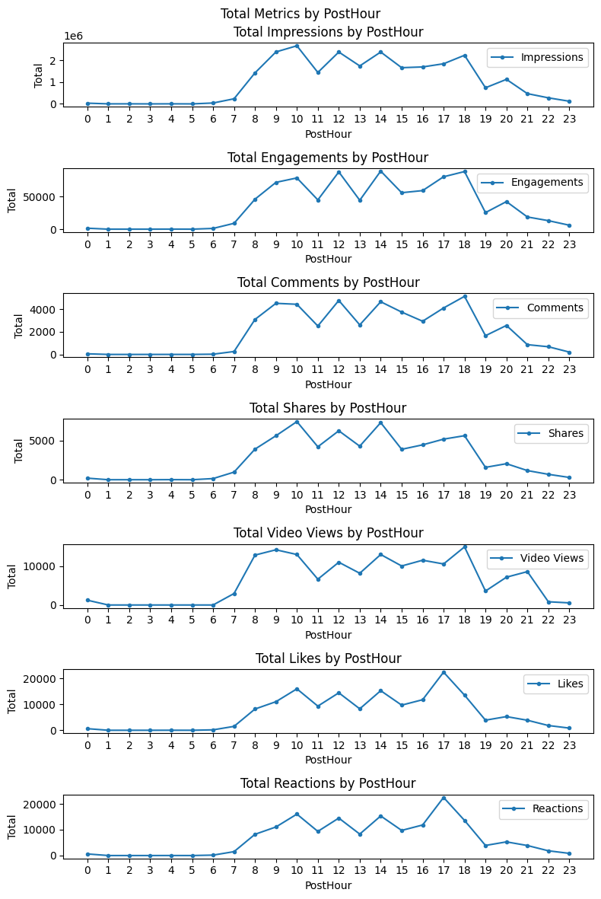
Hourly analysis
There is a clear diurnal pattern to social media engagement. People are most likely to engage with social media posts in the early afternoon and early evening when they are most likely to be checking their phones and computers.
Social media engagement is lowest in the early morning and late evening.
The best time to post for maximum engagement is between 10 a.m. and 4 p.m.

Slide 26
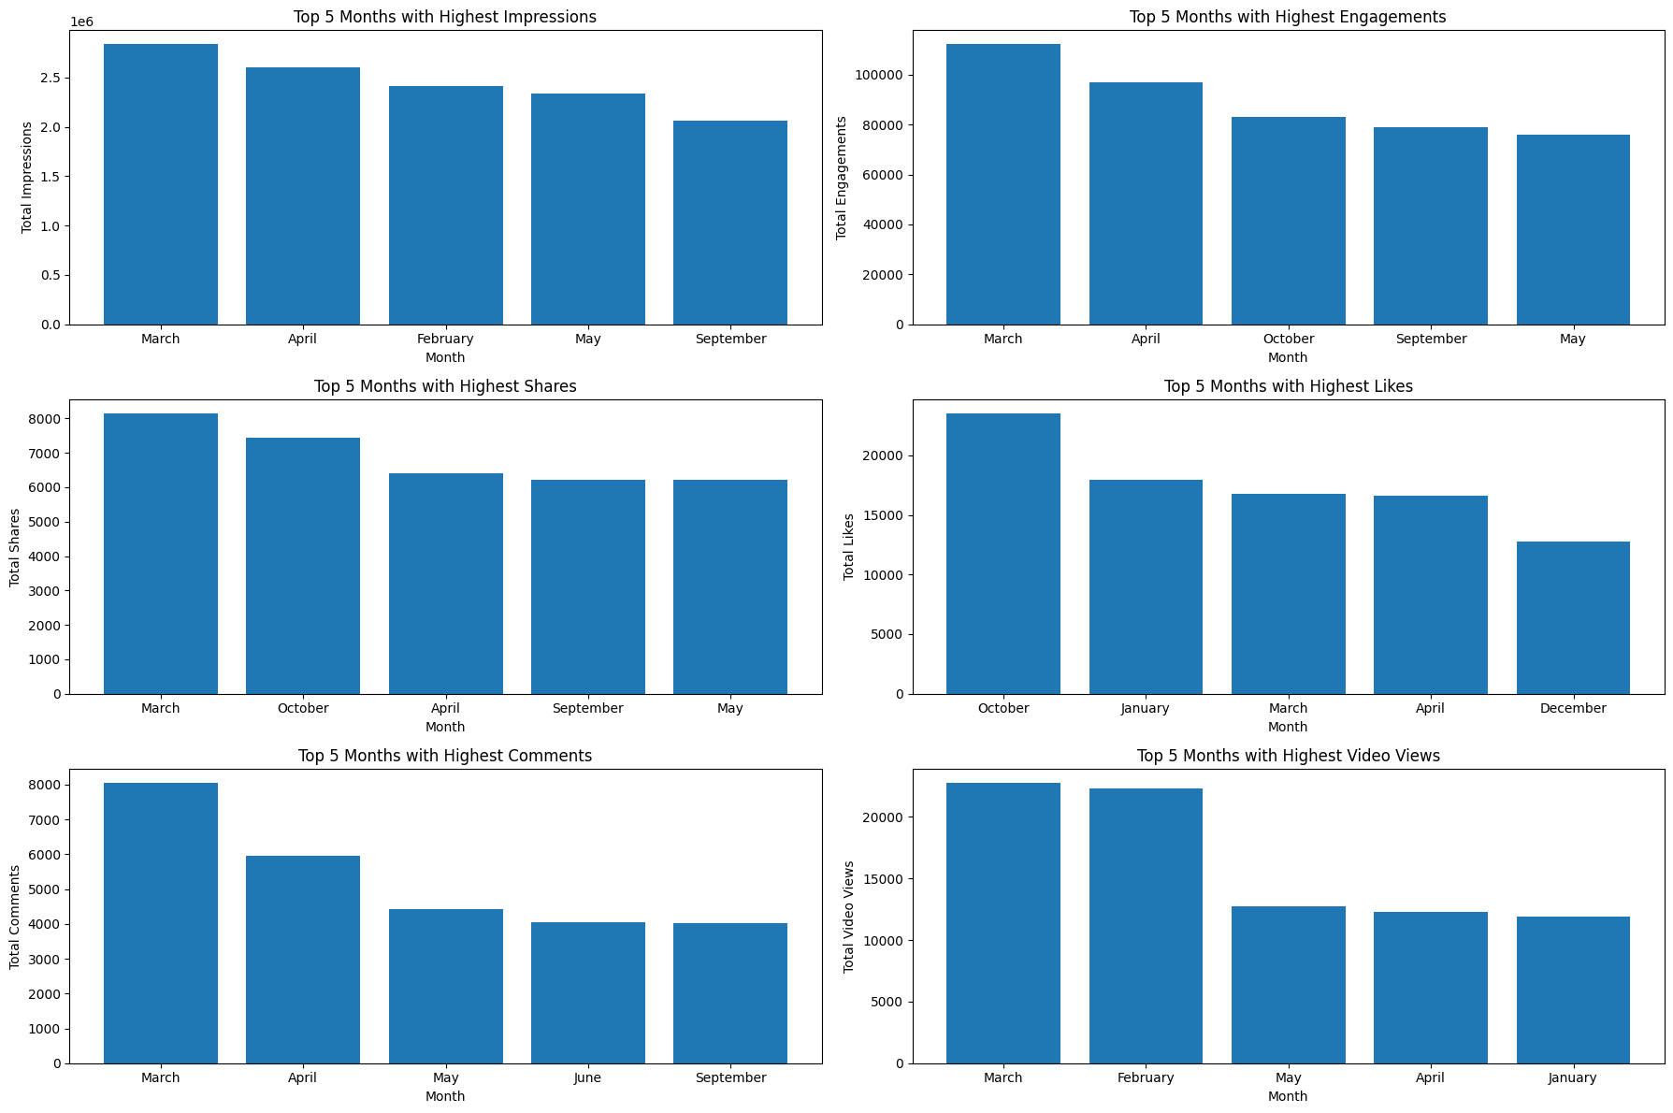
Monthly analysis

Slide 27
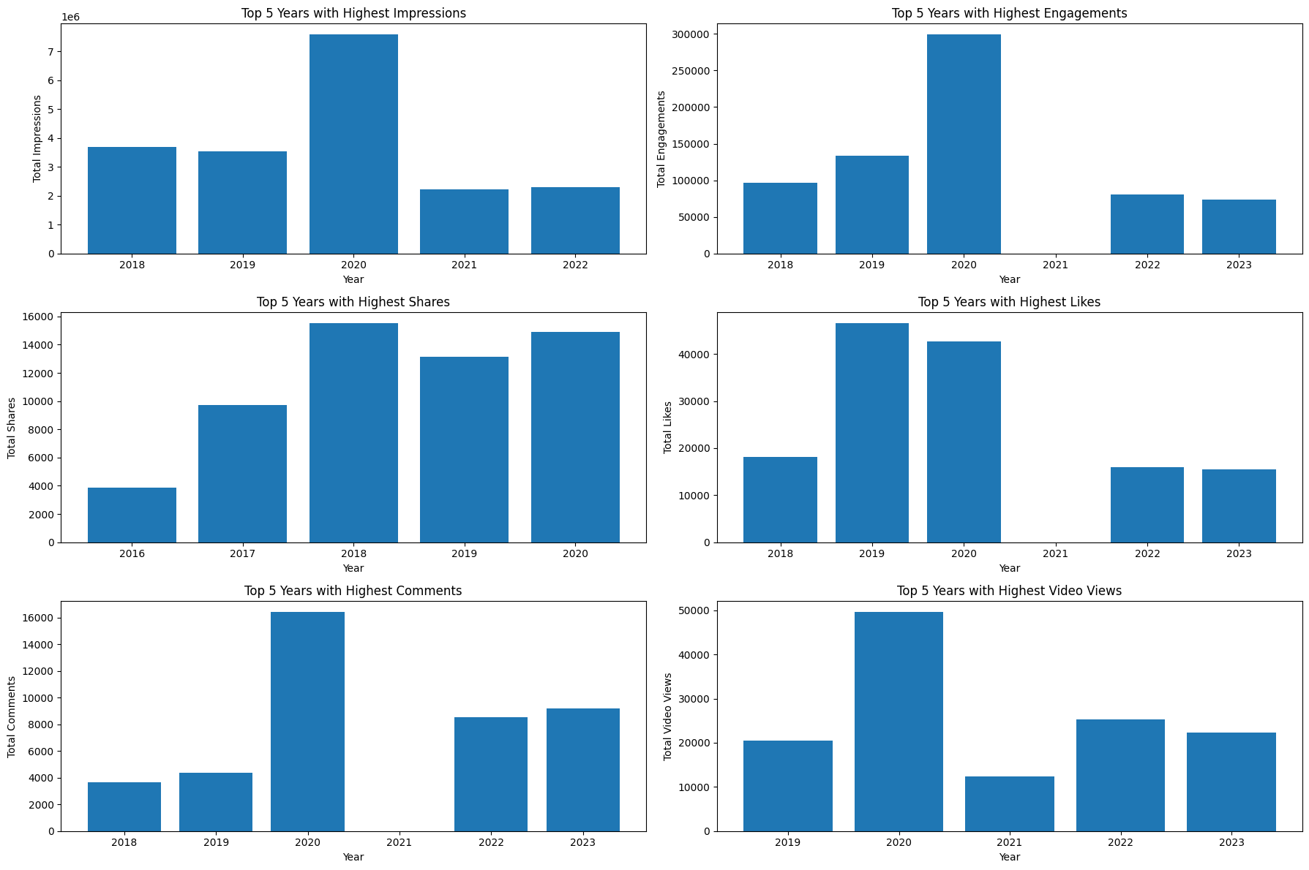
Yearly Analysis

Slide 28
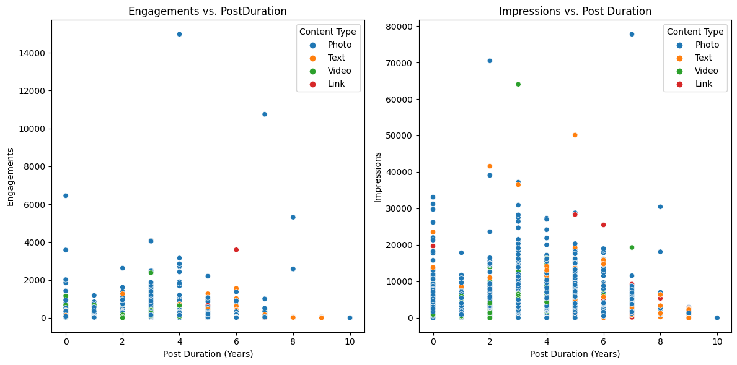
Post Duration Analysis

Slide 29
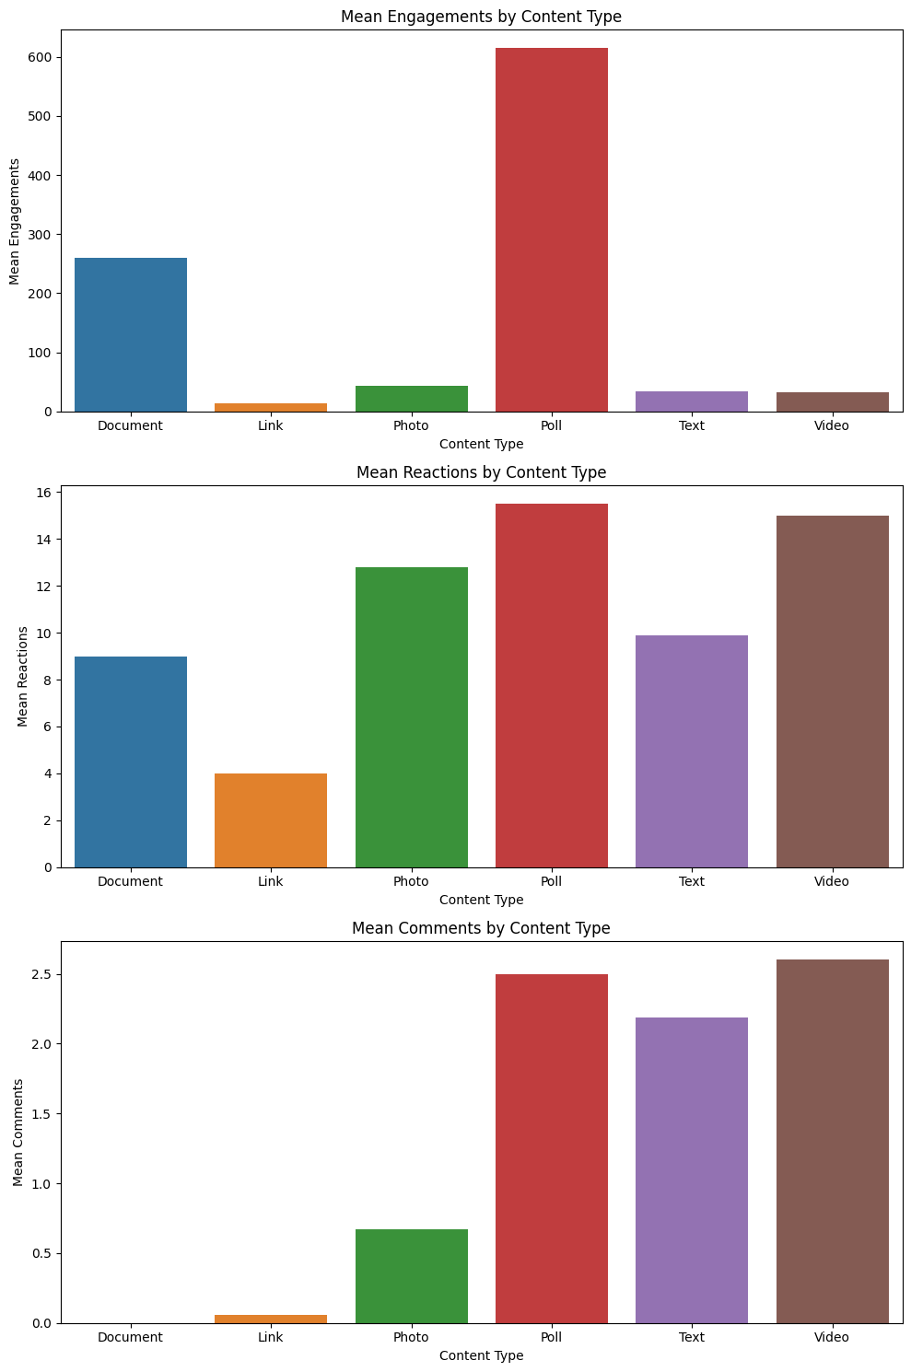
LINKEDIN ANALYSIS
Poll content ranks highest in terms of engagement and reactions closely followed by videos and documents.
A significant majority of the audience shows less preference for links and text.
Videos tend to receive the most comments compared to other content types.

Slide 30
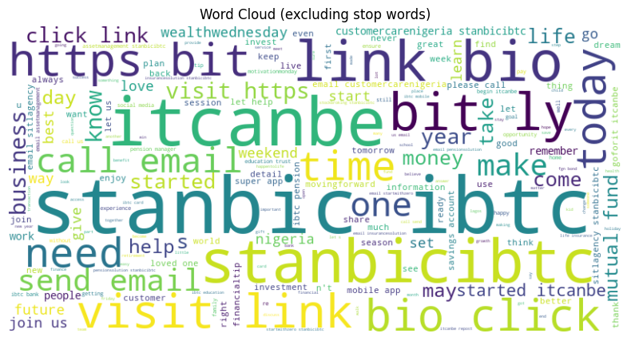
LINKEDIN WORD CLOUD

Slide 31
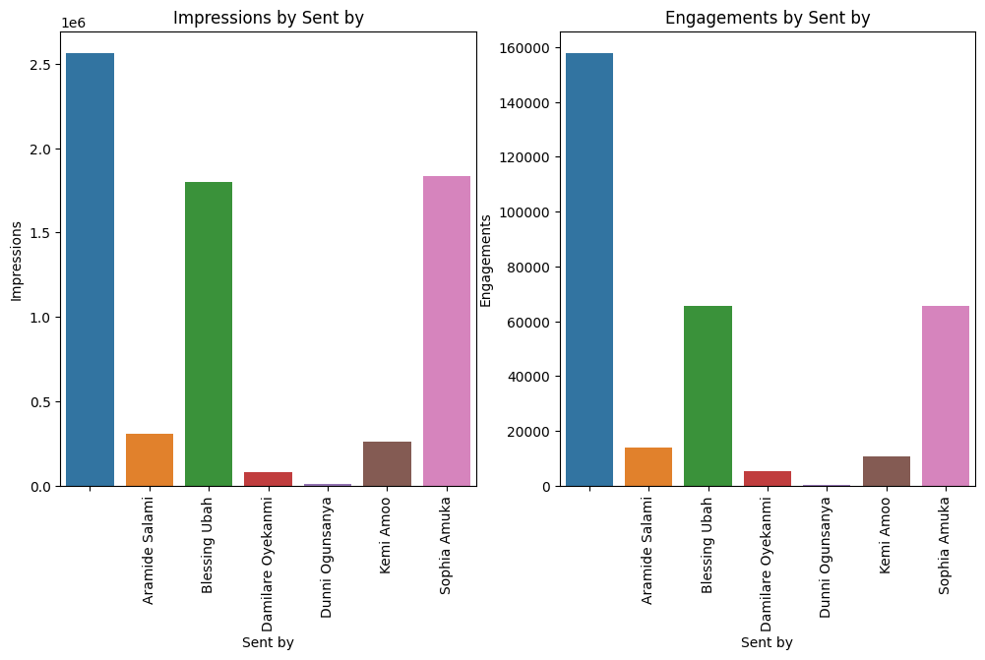
Sent By Analysis
Within the LinkedIn platform 'Others’, Sophia Amuka and Blessing Ubah have consistently generated the highest number of impressions and engagements.

Slide 32
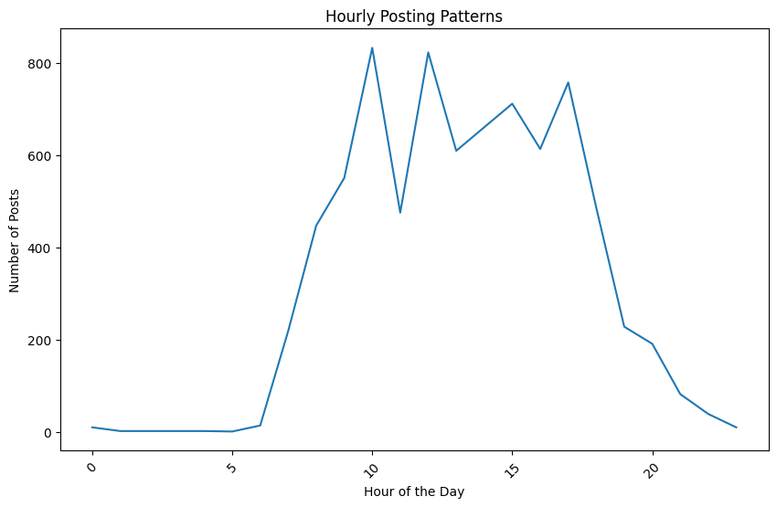
Time Series Analysis
The majority of audience engagement on LinkedIn is concentrated during the peak hours of 10 a.m.,3 p.m., and 5 p.m., with the least engagement observed during the early morning and late evening hours.

Slide 33
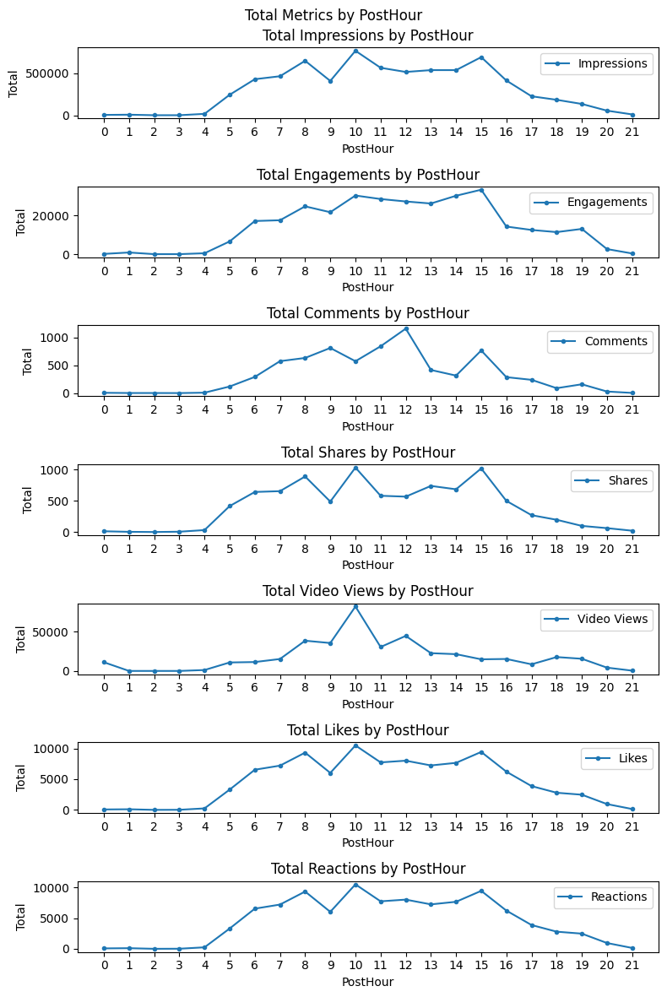
Hourly Metric Analysis
There is a clear diurnal pattern to social media engagement. People are most likely to engage with social media posts in the early afternoon and early evening when they are most likely to be checking their phones and computers.
Social media engagement is lowest in the early morning and late evening.
The best time to post for maximum engagement is between 10am and 4pm.

Slide 34
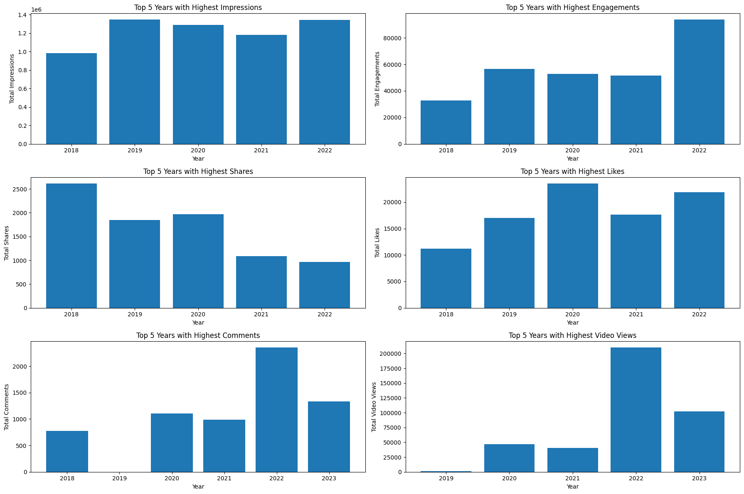
Yearly Metric Analysis
In my analysis, 2020,2021 and 20222 ranks among the top 5 years with the highest number of engagements, impressions, shares, likes, comments, and video views.

Slide 35
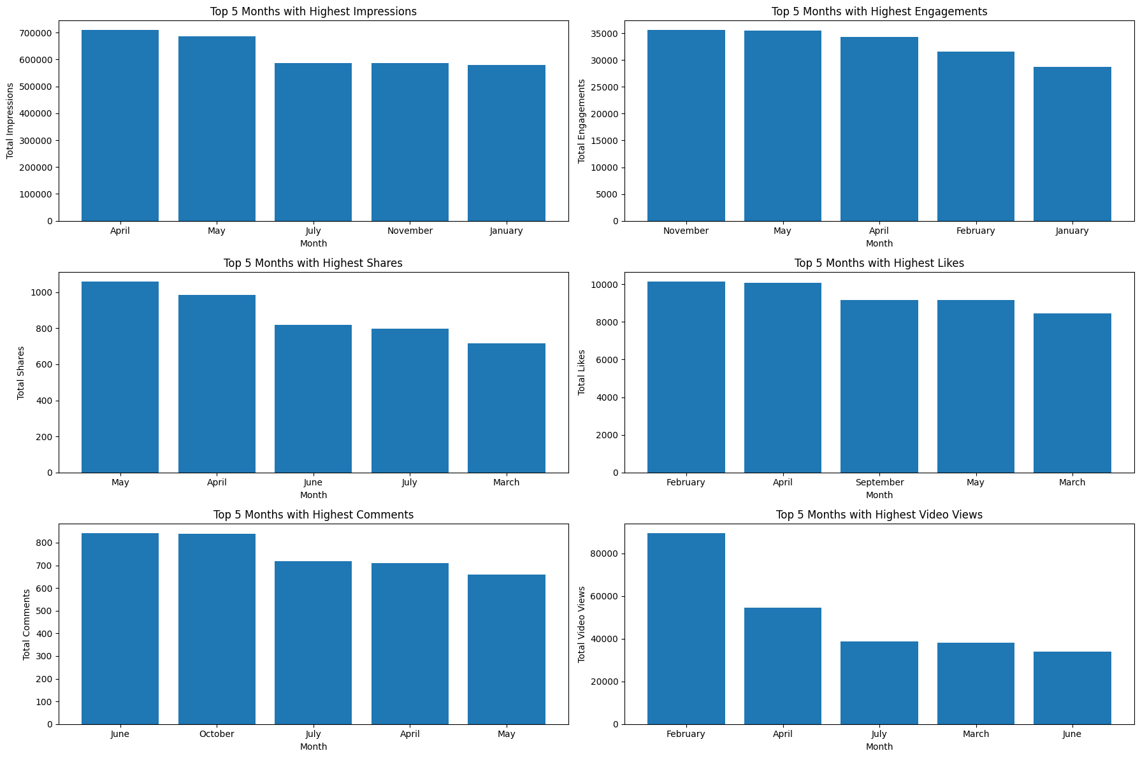
Monthly Analysis
In my analysis, May and April rank among the top 5 months with the highest number of engagements, impressions, likes, comments, and shares.

Slide 36
FACEBOOK ENGAGEMENT AND CONTENT TYPE PREDICTIONS
ENGAGEMENT PREDICTIONS
Predictive analytics is a powerful approach for extracting insights from data and guiding data-informed decision-making. In this notebook, I delve into predictive analysis using a Facebook dataset as the foundation. My primary focus is on predicting "Engagements,“ and “Content Type” a critical metric in the realm of social media. Engagements encompass various interactions with content, such as likes, shares, reactions, comments, and saves. These interactions signify how many individuals have not only viewed but actively engaged with the content. I leverage the carefully selected features retained throughout my analysis to achieve these predictions.
Mean Absolute Error of Random Forest is 3.1493
CONTENT TYPE PREDICTIONS
The accuracy of Random Forest Classifier is 0.9982

Slide 37
INSTAGRAM ENGAGEMENT AND CONTENT TYPE PREDICTION
ENGAGEMENT PREDICTIONS
Predictive analytics is a powerful approach for extracting insights from data and guiding data-informed decision-making. In this notebook, I delve into predictive analysis using a Instagram dataset as the foundation. My primary focus is on predicting "Engagements,“ and “Content Type” a critical metric in the realm of social media. Engagements encompass various interactions with content, such as likes, shares, reactions, comments, and saves. These interactions signify how many individuals have not only viewed but actively engaged with the content. I leverage the carefully selected features retained throughout my analysis to achieve these predictions. Random Forest Model performed best in my Models
Mean Absolute Error of Random Forest Regressor is 1.6740
CONTENT TYPE PREDICTIONS
Accuracy of Random Forest Classifier is 0.9971

Slide 38
TWITTER ENGAGEMENT AND CONTENT TYPE PREDICTIONS
ENGAGEMENT PREDICTIONS
Predictive analytics is a powerful approach for extracting insights from data and guiding data-informed decision-making. In this notebook, I delve into predictive analysis using a Twitter dataset as the foundation. My primary focus is on predicting "Engagements," and “Content Type” critical metrics in the realm of social media. Engagements encompass various interactions with content, such as likes, shares, reactions, and comments. These interactions signify how many individuals have not only viewed but actively engaged with the content. I leverage the carefully selected features retained throughout my analysis to achieve these predictions.
Mean Absolute Error of Random Forest is 2.2019
CONTENT TYPE PREDICTIONS
Accuracy of Random Forest Classifier is 0.9988

Slide 39
LINKEDIN ENGAGEMENT AND CONTENT TYPE PREDICTIONS
ENGAGEMENT PREDICTIONS
Predictive analytics is a powerful approach for extracting insights from data and guiding data-informed decision-making. In this notebook, I delve into predictive analysis using a LinkedIn dataset as the foundation. My primary focus is on predicting "Engagements,“ and “Content Type” a critical metric in the realm of social media. Engagements encompass various interactions with content, such as likes, shares, reactions, comments, and saves. These interactions signify how many individuals have not only viewed but actively engaged with the content. I leverage the carefully selected features retained throughout my analysis to achieve these predictions.
Mean Absolute Error of Gradient Boosting Regressor is 2.2247
CONTENT TYPE PREDICTIONS
Accuracy of Random Forest Classifier is 0.9994

Slide 40
INSIGHTS UNCOVERED
Facebook is the leading in user engagement with 46 million reach, second in rank is Instagram with 13 million, Twitter with 158K, and least is LinkedIn with 100K.
Most people engage with content on all platforms from 10 am to 4 pm and the least engagements are made early in the morning and late in the evenings.
Photos are the most engaged content type on Facebook, Twitter, and Instagram.
Polls and documents are the most engaged on LinkedIn.
Most people react to polls, videos, and photos.
Most people comment on polls, texts, and videos.
The least engaging content types on Facebook are links and texts.
The least engaging content types on Instagram are carousels and videos.
The least engaging content types on Twitter are links and texts.
The least engaging content types on LinkedIn are links and texts.
Most people engage with posts on Instagram sent by “others”, Araminde Salami and Blessing Ubah.
Most people engage with posts on Twitter sent by “others” and Sophia Amuka.
Most people engage with posts on LinkedIn sent by “others”, Sophia Amuka, and Blessing Ubah.
Facebook’s mean absolute error on engagement and accuracy of content type prediction was 3.1493 and 0.9982.
Instagram's mean absolute error on engagement and accuracy of content type prediction was 1.6740 and 0.9971
Twitter’s mean absolute error on engagement and accuracy of content type prediction was 2.2247 and 0.9994.
LinkedIn’s mean absolute error on engagement and accuracy of content type prediction was 2.2019 and 0.9988.

Slide 41
RECOMMENDATIONS FROM INSIGHTS UNCOVERED
Leverage Facebook's strong engagement to continue building your brand presence and consider strategies to boost engagement on Instagram and Twitter.
Incorporate high-quality photos within the texts and links to enhance user engagement, since most users engage with photos.
Schedule your content to align with peak engagement times to maximize reach and impact.
Invest in visual content like photos and videos across platforms. On LinkedIn, prioritize sharing polls and informative documents to boost engagement. Create engaging polls and video content to encourage user reactions and increase interaction.
Collaborate with these top-engaging profiles (sent by ) to increase your reach and engagement. Their audience trust can benefit your brand.
Share these insights with the company’s social media managers, and train and mentor them on how to engage with your users across different social media platforms.
Create a series of visually engaging images that together tell a story or convey a message.
Encourage discussions by using polls and thought-provoking text content. Respond to comments to foster engagement, in the polls and suggest questions like “ What was your worst interaction with StanbicIBTC”
Use advertising techniques such as LinkedIn Ads to reach out to your audience.
Focus on Content Quality on Facebook.
Optimize Content Strategy for Instagram.
Refine Engagement Strategies on Twitter.

Slide 42
Recommendations
Focus on creating content that is relevant to your target audience. The words in the word cloud suggest that your target audience is interested in topics such as wealth, money, business, and investment. You should focus on creating content that is relevant to these topics.
Improve Link Engagement: While links may receive lower impressions, focus on improving their engagement by optimizing the content you share. Craft compelling headlines, use eye-catching images or previews, and ensure that the linked content provides value to your audience.
Use simple and clear language. The words in the word cloud are all relatively simple and easy to understand. You should avoid using jargon or technical language in your content.
Use images and videos to make your content more visually appealing. The words in the word cloud suggest that your target audience is interested in visual content. You should use images and videos in your content to make it more visually appealing and engaging.
Use relevant hashtags. Hashtags are a great way to get your content seen by more people. You can use relevant hashtags in your posts to make them more visible to people who are interested in the topics you are covering.
Track your progress and make adjustments as needed. You can use social media analytics to track your progress and see what is working well and what is not. You can use this information to improve your social media strategy over time.
Partner with other creators. You can partner with other creators to create content together, or you can feature other creators' content on your platform. This is a great way to reach a new audience and get more exposure for your content.
Run social media contests and giveaways. This is a great way to engage your audience and attract new followers. You can give away prizes that are relevant to your target audience.
Use social media advertising to reach a wider audience. Social media advertising can be a great way to reach a wider audience and promote your content. You can target your ads to people who are interested in the topics you are covering.
Diversify Content Types: Recognize that different content types work better on various platforms. Use photos, videos, and polls on platforms where they perform best. Adjust your content mix accordingly.

Slide 43
PREDICTION RECOMMENDATIONS
Facebook Recommendations:
Improve Engagement Predictions: Given the relatively high MAE on engagement prediction for Facebook, consider fine-tuning your content strategy based on historical engagement data.
Refine Content Type Prediction: While the accuracy of content type prediction is high, continue to validate and refine your content categorization model to ensure that the right content is being delivered to your audience.
Instagram Recommendations:
Maintain Content Quality: Instagram has a relatively low MAE on engagement, which suggests that your current content strategy is effective. Continue to prioritize high-quality visuals and engaging content that aligns with your brand's aesthetics and objectives.
Monitor Content Type Accuracy: While the accuracy of content type prediction is high, periodically review the accuracy to ensure that Instagram's algorithm correctly categorizes your content. Make adjustments as needed.
Twitter Recommendations:
Fine-Tune Engagement Strategy: With a moderate MAE on engagement for Twitter, analyze your past Twitter engagement patterns. Consider experimenting with different tweet formats, posting frequencies, and engagement strategies to optimize user interaction.
Validate Content Type Prediction: Twitter's content type prediction accuracy is high, but it's essential to review and validate the categorization periodically. Ensure that your tweets are correctly categorized to maintain relevance.
LinkedIn Recommendations:
Enhance Engagement Efforts: LinkedIn's MAE on engagement is relatively high. Focus on strategies to boost engagement, such as sharing industry insights, thought leadership content, and engaging with LinkedIn groups and communities to foster discussions.
Review Content Type Accuracy: Validate the accuracy of content type prediction on LinkedIn regularly. Ensure that your posts are correctly classified, and adjust your content strategy based on the results.

